Slide 1
Pair-Wise Testing And Orthogonal array testing
Lecture #17

Slide 2
Pair-Wise Testing
Pair-wise testing means that each possible combination of values for every pair of input variables is covered by at least one test case.
Pair-wise testing is also referred to as all-pair/two-way testing. One can also generate three- four-way or 4-way tests to cover all combinations of values of three or four variables.

Slide 3
Empirical results [5] for medical devices and distributed database systems show that two-way
testing would detect more that 90% of the defects, whereas, four-way testing would detect 100% of the defects. Pairwise testing would detect approximately 70% of the defects, whereas six-way testing would detect 100% of defects for browser and server applications.

Slide 4
Example
Consider the system S , which has three input variables X, Y, and Z.
Let the notation D(w) denote the set of values for an arbitrary variable w. For the three given variables X, Y, and Z, their value sets are as follows:
D(X) = {True, False}, D(Y) = {0, 5}, and D(Z) = {Q,R}.

Slide 5
The total Number of test Cases will be
2*2*2=8

Slide 6
Orthogonal array testing
Orthogonal array testing is a black box testing technique that is a systematic, statistical way of software testing. It is used when the number of inputs to the system is relatively small, but too large to allow for exhaustive testing of every possible input to the systems.

Slide 7
Mandl was the first to use the concept of orthogonal array in designing test cases for pairwise testing of compilers.

Slide 8
Choose any two columns at random and find
all pairs (1,1), (1,2), (2,1), and (2,2);

Slide 9
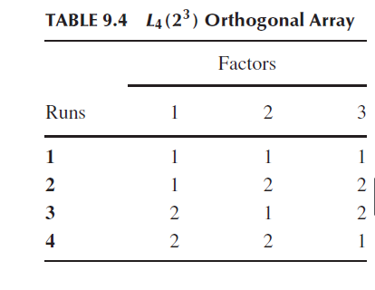

Slide 10
The 4 indicates that the array has four rows,
also known as runs.
The 2^3 part indicates that the array has three columns, known as factors, and each cell in the array contains two different values, known as levels.
Levels mean the maximum number of values that a single factor can take on.

Slide 11
Example
Let us consider our previous example of the system S, where S has three
input variables X, Y, and Z. For the three given variables X, Y, and Z, their value
sets are as follows: D(X) = {True, False}, D(Y) = {0, 5}, and D(Z) = {Q,R}.
Let us map the variables to the factors and values to the levels onto the L4(2^3) orthogonal array

Slide 12
In the first column, let 1 = True, 2 = False. In the second column, let 1 = 0, 2 = 5. In the third column, let 1 = Q, 2 = R.

Slide 13
Note that not all combinations of all variables have been selected; instead combinations of all pairs of input variables have been covered
with four test cases.

Slide 14
How to Select Subset?
It is clear from the above example that orthogonal arrays provide a technique for selecting a subset of test cases with the following properties:
• The technique guarantees testing the pairwise combinations of all the selected variables.
• The technique generates fewer test cases than the all-combination approach.

Slide 15
Cont.
• The technique generates a test suite that has an even distribution of all pairwise combinations.
• The technique can be automated.

Slide 16
In the following, the steps of a technique to generate orthogonal arrays are presented.

Slide 17
Steps for orthogonal Array
Step 1: Identify the maximum number of independent input variables with which
a system will be tested. This will map to the factors of the array—each
input variable maps to a different factor.
Step 2: Identify the maximum number of values that each independent variable
will take. This will map to the levels of the array.
Step 3: Find a suitable orthogonal array with the smallest number of runs
LRuns(XY ), where X is the number of levels and Y is the number of
factors [7, 13]. A suitable array is one that has at least as many factors
as needed from step 1 and has at least as many levels for each of those
factors as identified in step 2.
Step 4: Map the variables to the factors and values of each variable to the levels
on the array.
Step 5: Check for any “left-over” levels in the array that have not been mapped.
Choose arbitrary valid values for those left-over levels.
Step 6: Transcribe the runs into test cases.

Slide 18
Solve the example of book before Class.

